Slide 1

EyeCloud
Introducing for RxIT management team
September 2021
© ESSILOR – Group IT Solutions / Digital Innovation – For internal use only. Do not disclose or copy.

Slide 2
EyeCloud
Introducing for RxIT management team
September 2021
Introducing
Architecture, EC objects/vocabulary
Samples of use cases
© ESSILOR – Group IT Solutions / Digital Innovation – For internal use only. Do not disclose or copy.

Slide 3




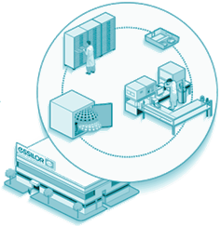
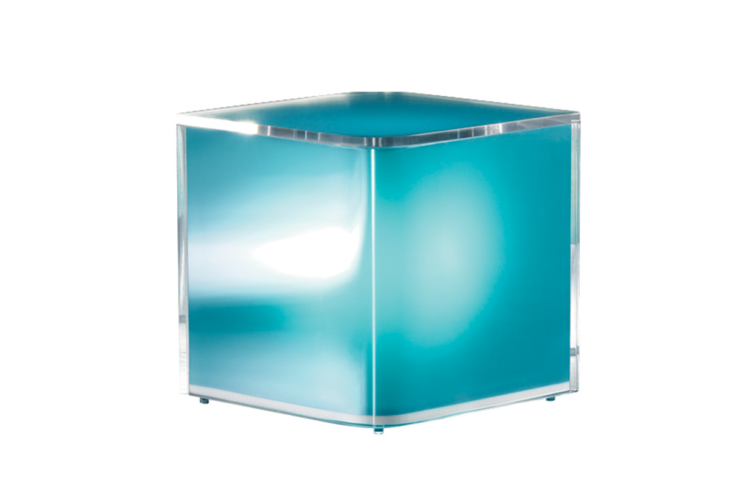





What is EyeCloud
"EyeCloud is enabler for Rx systems"
The main purpose of EyeCloud is to EASE the exchanges of informations (data, files) between Rx chain systems by avoiding duplicate storage of data/files in each system of the chain.
EyeCloud benefits:
Provides unique ID
Can store any kind of info (files any format or metadata) in a centralized storage in the cloud.
Secure the storage
^{Platform of services above EC}

Slide 4

EyeCloud service level agreement
Business Expectations
Services Capabilities
24/7 business with on-duty support
24/7 Support & monitoring
No disruption during hours of operations
99.9% Unplanned Downtime by 2019
All P1 addressed in 1H & resolved* in 4H.
Storage of data for 3y (hot storage) + 2y (cold storage)
Storage of data for 3y (hot storage) + 2y (cold storage)
not in place yet

Slide 5
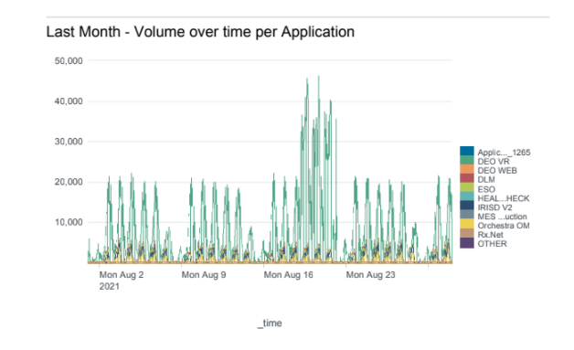
EyeCloud service level agreement

Slide 6
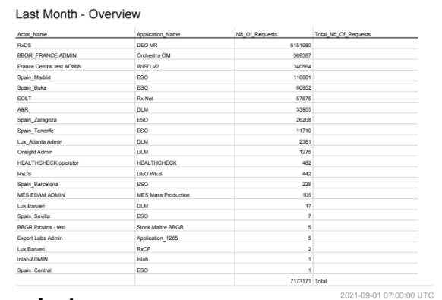
EyeCloud service level agreement

Slide 7
How EyeCloud eases exchanges ?
Provides unique ID for order, lenses, frames
Can store any kind of info (files any format or metadata) in a centralized storage in the cloud.
Secure the storage: AWS services usage (S3, dynamoDB), multi regions high availability (2021’s roadmap, to be done), regular penetration tests (2018, 2021 expected)

Slide 8
EyeCloud
Introducing for RxIT management team
September 2021
Introducing
Architecture, EC objects/vocabulary
Samples of use cases
© ESSILOR – Group IT Solutions / Digital Innovation – For internal use only. Do not disclose or copy.

Slide 9
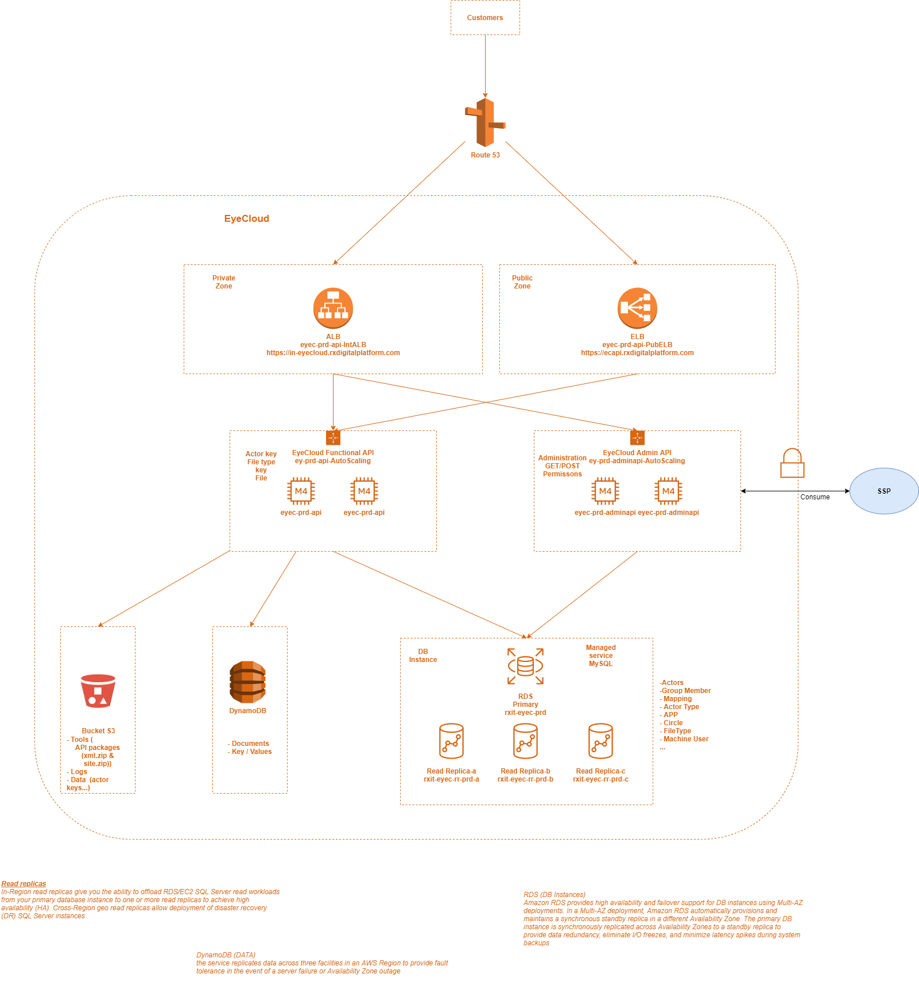
Today’s EyeCloud architecture
1 EC platform in AWS Ireland (no HAMR multi regions yet)
Private entry / load balancer (ALB) for internal flow
Public entry / load balancer (ELB) for external/internet flow
2 sets of API:
functional API: using by calling systems to get ID, post/get data/documents.
admin API: using by SSP/support team to give permission to calling systems.
Storage layer:
S3 + DynamoDB for data/document (by functional API)
MySQL for keys/permissions

Slide 10
Tomorrow’s EyeCloud architecture > HAMR AA
Orchestra
Inlab
Rx.Net
B2B portal
Walmann
OnSight
Orchestra
Inlab
Rx.Net
B2B portal
Orchestra
Inlab
Rx.Net
Benefits (vs current EC)
High Availability multi-regions Active/Active
Performance
Leverage RxDS std authorization layer
R53
Get ECID
Post data/document
Get data/document
Pool ECID
Dynamo - GT
ALB int
ALB ext
ALB int
ALB ext
EC functional API 2.7.3
Provides of unique ECID on the fly | batch mode.
if the number of ID is below X, regenerate a pool of ID
Provides of unique ECID on the fly | batch mode.
if the number of ID is below X, regenerate a pool of ID
Regional pool of ECID
Regional pool of ECID
Stores (POST) document / metadata
Stores (POST) document / metadata
Provides (GET) document / metadata
Provides (GET) document / metadata
Authentication Authorization
Authentication Authorization
MySQL
S3
MySQL
S3
AWS IE
AWS CA

Slide 11
Tomorrow’s EyeCloud architecture > HAMR AA
Pillars / Approach / Principales
2 platforms: AWS IE+CA
Usage of global db layer (Dynamo GT if AWS) to share a unique ID between regions. This db is called “IDs global pool”
A regional pool of IDs for performance. Each regional pool is an extract of the “IDs global pool”.
Home made permission layer will be replaced by RxDS permission standard layer (AuthZ).
Orchestra
Inlab
Rx.Net
B2B portal
Walmann
OnSight
Orchestra
Inlab
Rx.Net
B2B portal
Orchestra
Inlab
Rx.Net
R53
Get ECID
Post data/document
Get data/document
Pool ECID
Dynamo - GT
ALB int
ALB ext
ALB int
ALB ext
EC functional API 2.7.1
Provides of unique ECID on the fly | batch mode.
if the number of ID is below X, regenerate a pool of ID
Provides of unique ECID on the fly | batch mode.
if the number of ID is below X, regenerate a pool of ID
Regional pool of ECID
Regional pool of ECID
Stores (POST) document / metadata
Stores (POST) document / metadata
Provides (GET) document / metadata
Provides (GET) document / metadata
Authentication Authorization
Authentication Authorization
MySQL
S3
MySQL
S3
AWS IE
AWS CA

Slide 12
EyeCloud objects/vocabulary
Real life | Sample | Eyecloud object(s) | Sample of EC object
Lab / ECP / ... | Columbus
Calling system application | Rx.Net | EC application key 1 application key per application | a-0bb2a895-9a10-4c65-8ac2-0413d06f4850
Calling system application instance | Rx.Net Columbus | EC actor key 1 actor key per instance | t-68968036-40a7-4e1c-919e-1096d47432ec
Type of document: | Calculation result DLM files Traceability files Delivery note e-warranty card ... | EC filetype key by default, 1 filetype key per type of document but can have exception. For instance, for confidentiality purpose, 2 filetype keys can be created for the same type of document,but with different permission. | c-59353d92-cdcb-4e9c-9086-6bee6c9acd54 for traceability file g-72a94428-4456-488a-8ad8-009bbfcf4c38 for Delivery Note g-9c309eda-bc6e-4fba-ae93-0709f5ac6373 for e-warranty card
Order | 811244 | UOID | cn9kw27y

Slide 13
EyeCloud “Unique” ID
Unique Order ID (UOID)
Pattern:A*N*A*N*
Length: 8
Type Of character:AlphaNumeric
A: Stands for Alpha excludes i,j and o
N: Stands for Numeric excludes 0 and 1
*: Stands for AlphaNumeric [No exclusives .All alpha and numeric characters]
Rule to check the unicity :
1.Generation of random key
2.The generated random key has been validated against the dynamo db Id tables using query operator for its existence.

Slide 14
EyeCloud
Introducing for RxIT management team
September 2021
Introducing
Architecture, EC objects/vocabulary
Samples of use cases
© ESSILOR – Group IT Solutions / Digital Innovation – For internal use only. Do not disclose or copy.

Slide 15
Sample 1

Slide 16
Samples of current problematic possibly resolved by EyeCloud > RxML & DLM
RxML out
Datalake
ECID → DLM
2
4
1
2
External labs
RxML In
RxML In
Walmann, OnSight,
DVI | Optifacts | VisionStar
DEO MQ
DEO
Saturn 2.0
6
5
... _LDPATH
_SFMODE
RxML Out with _LDPATH for DLM
(URL+ID)
RxML Out
including DLM
RxML
In / out
RxML
In / out
1
3
3
1
3
A&R
LensMapper
External labs
Internal
labs

Slide 17
Samples of current problematic possibly resolved by EyeCloud > RxML & DLM
ECID → DLM
4
1
2
External labs
RxML In
RxML In
Walmann, OnSight,
DVI | Optifacts | VisionStar
DEO MQ
DEO
Saturn 2.0
7
6
RxML Out
including DLM
LDPATH
SFMODE
RxML Out with LDPATH+SFMODE for DLM
(ID+URL)
3
A&R
LensMapper
5

Slide 18
Sample 2

Slide 19
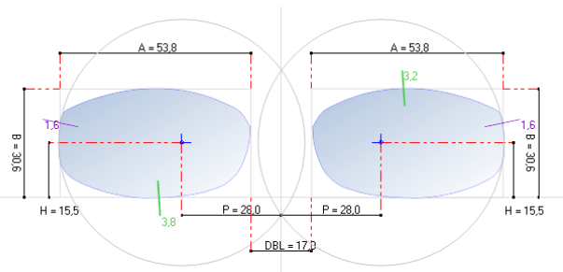
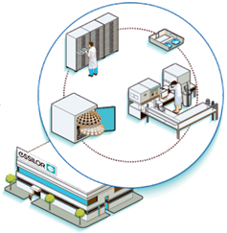
Samples of current problematic possibly resolved by EyeCloud > Shape files 1/2
Btw march 11 and 18th 2020, 135K⁽¹⁾ shape files have been received by Generix⁽²⁾ and broadcasted to downstream IS
(7M in 52W)
Broadcast to all serving labs (Inlab, Rx.Net)
RxML including the shape
Shape file extracted from RxML
ECP shop
Generix
Opsys Web
Orchestra
Essibox
⁽¹⁾ source: Generix support team, David Reverchon & Bernard Evan, march 21th 2018
⁽²⁾excludes non EDI orders and EDI by other platform than Generix (e.g: ECG)

Slide 20
Samples of current problematic possibly resolved by EyeCloud > Shape files 2/2
Ask for new UEID
UEID
….Metadata
………Prescription
………PMS order ID
….Document
………Calcul 1
………Shape file
New UEID
UEID
Post Shape file and metadata on UEID
UEID
….Metadata
………Prescription
………PMS order ID
….Document
………Calcul 1
………Shape file
………Calcul 2
Get shape file on UEID
UEID
UEID
UEID
….Metadata
………Prescription
………PMS order ID
….Document
………Calcul 1
………Shape file
………Calcul 2
………Calcul 3
Get shape file on UEID
Get shape file on UEID

Slide 21
Sample 3

Slide 22

Samples of current problematic possibly resolved by EyeCloud > Traceability for EU
2
2
Web ordering system
Ordering management system
LMS
3
ECID A
ECID A
Picking
Traceability file (many info) POST on ECID A
Formater
GS1-->Traceability format
1
4
Business Sub Web portal
EyeCloud
“GET traceability for ECID A”
5
Datalake
Massive queries
Internal Quality
Traceability info
Traceability info
Traceability info

Slide 23
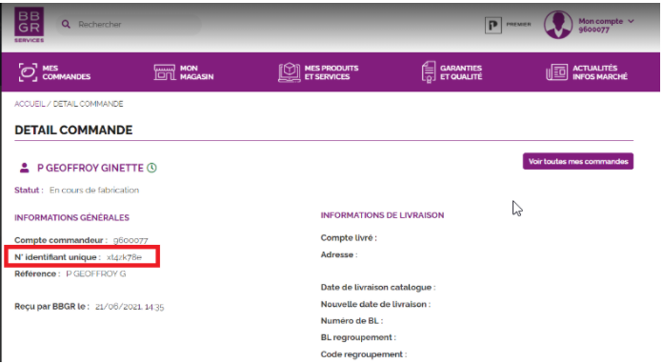
Samples of current problematic possibly resolved by EyeCloud > Traceability for EU
2
2
Web ordering system
Orchestra
Gold + HubOne + Stock Maitre
3
ECID A
ECID A
Formater
GS1-->Traceability format
1
4
BBGR Essilor Pro
EyeCloud
“GET traceability for ECID A”
5
Datalake
Massive queries
Internal Quality
Traceability info
Traceability info
Traceability info

Slide 24
Sample 4

Slide 25



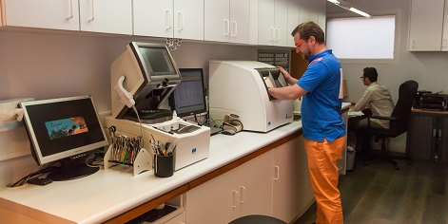
Samples of current problematic possibly resolved by EyeCloud > CCS improve 1/2
Sorry dear client….we’ll make you an adjustment.
-€ for Essilor
+€ for ECP
Why my lens doesn’t have the same properties (calculation results) as expected ?
Calc.D
ECP shop
Generix
Opsys Web
Orchestra
Inlab
Calc.A
Calc.B
Calc.C
Calculation D is the one from which the lenses are produced
Calc.D
Calc.E
Use case: Result(A)=Result(B) <> Result(C)

Slide 26




Samples of current problematic possibly resolved by EyeCloud > CCS improve 2/2
Ask for new UEID
UEID
….Metadata
………AAAA
………BBBB
….Document
………Calcul A
New UEID
Post doc and metadata on UEID
UEID
UEID
….Metadata
………AAAA
………BBBB
….Document
………Calcul A
………Calcul B
Post calc.result and metadata on UEID
Why my lens doesn’t have the same properties (calculation result D) as expected ?
UEID
UEID
….Metadata
………AAAA
………BBBB
….Document
………Calcul A
………Calcul B
………Calcul C
………Calcul D
…
………Calcul n
We’ve noticed that with this SF, the results are better….
Post calc.result and metadata on UEID
Get Calc. Result on UEID
Calcul D
Challenge: being sure to get the trusted calculation result

